Slide 1


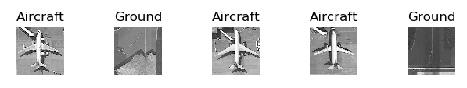
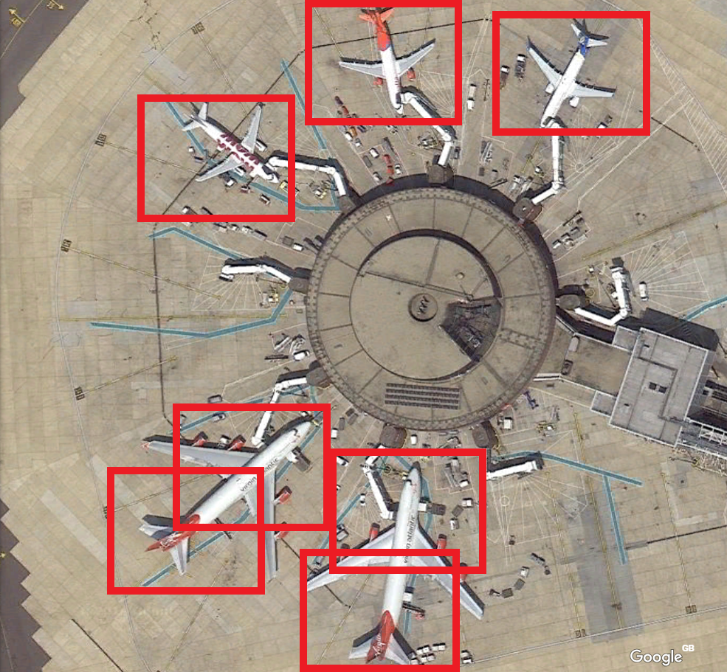
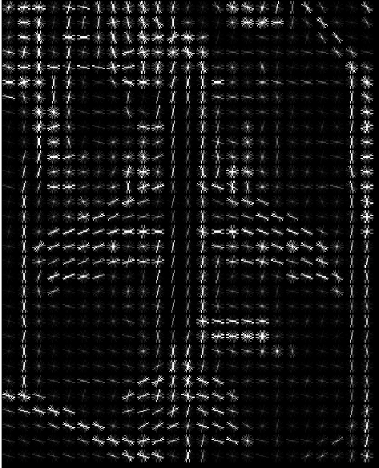
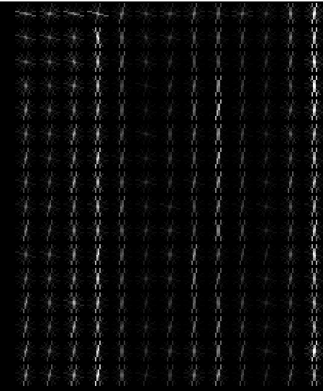
Identifying Aircraft from Above
Kai Roper-Blackman supervised by Sebastian Halder
Objectives:
To differentiate between Aircraft and Ground images
To identify aircraft of various sizes and orientations in a larger image such as an airport
Methods:
Pre-processing: Histogram of Oriented Gradients used to obtain feature descriptor. Describes image mathematically to Machine learning model
Support Vector Machine takes training data in the form of feature descriptors. Model evaluates the test images (in the form of feature descriptor) and returns prediction with associated probabilities.
Results:
Cross validation score of standalone images reached 100%
Ground images have a low variance in gradient whereas Aircraft have a high variance
Detection of aircraft in larger images results in accuracy of 50%-60%

